Slide 1
Networking across Boundaries: Enabling Wireless
Communication through the Water-Air Interface
跨越介质的通信：穿越水面与空气交界面的无线通讯方法
主讲人：周俊杰 2018282110212

Slide 2
背景介绍
Underwater communication networks all face the same problem: they cannot directly communicate across the water-air interface. Said differently, a deeply submerged sensor cannot directly communicate with another node above the water’s surface. This is because wireless signals exhibit different properties in different media making it hard to use any single type of signal for cross-medium communications .

Slide 3
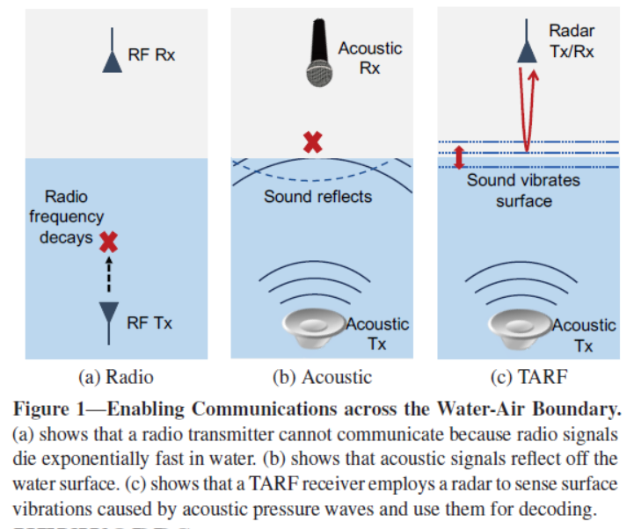
背景介绍

Slide 4
背景介绍
TARF（translational acoustic-RF communication）
（平移声学-射频通信）
首次实现水下节点与空气中的节点直接进行无线通讯的通讯方式
水下的声呐发生器发出声波会在水中产生压力波
压力波传播到水面后会导致水面产生微小的震动、位移
然后空气中节点上搭载的射频传感器会向水面发射射频信号
射频信号到达水面后会反射回去
由于水面产生的震动，会导致反射的射频信号发生变化
空气中的节点接收到反射信号后会进行解析
最终得出水下的声呐发生器发送的信息

Slide 5
技术难点
表面波振动很小，通常只有几到几十微米，难以检测；
由于表面波波纹小，很容易被海波掩盖，海波通常是表面波的3到6个数量级；
由于是跨介质的通信，因此发射器没法对整个的通信信道进行估测，也就很难指定合理的调制和编码方案；

Slide 6
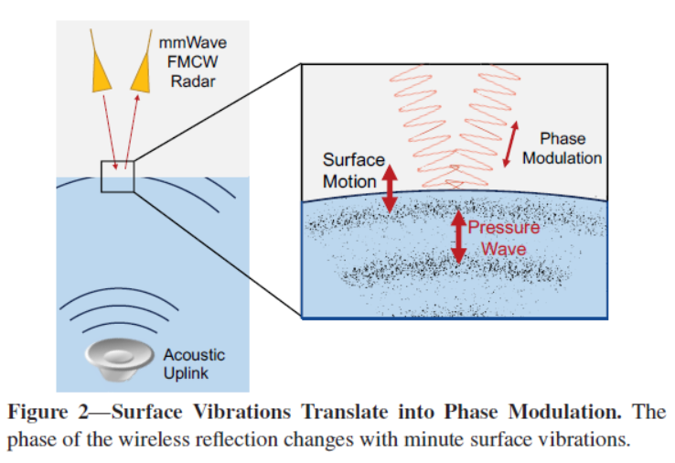
TARF OVERVIEW
Transmitter
Channel
Receiver

Slide 7

UNDERSTANDING THE TARF COMMUNICATION CHANNEL
underwater propagation
the water-air interface（重点）
in-air propagation
一、The water-air interface
These signals travel in the medium as pressure waves P (ω,t), which vary in time t and range r , and can be expressed as :
where A is the amplitude, ω is the angular frequency, and vw is the velocity in water.

Slide 8

UNDERSTANDING THE TARF COMMUNICATION CHANNEL
一、The water-air interface
How much surface displacement do acoustic pressure waves create?
假设入射波与水平面正交，可以得出表面位移δ与压力波 P 的关系：
where P is the overall pressure created by the acoustic wave and ρ is the density of water.
可以看出：表面位移与压力波成正比

Slide 9
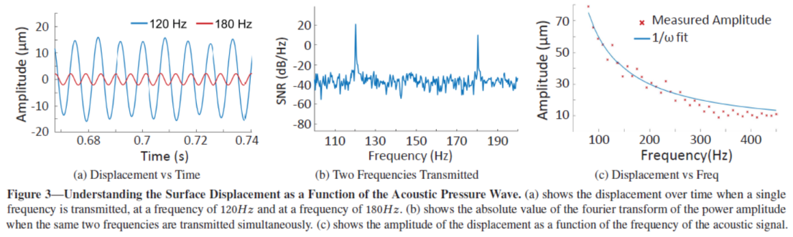
UNDERSTANDING THE TARF COMMUNICATION CHANNEL
由压力波产生的表面位移非常微小
由图a和图b可以看出，声波频率与水面上的位移是线性的关系，因此可以把水平面上的通信可以看做是一个线性非时变的信道，这样的信道便于后续调制和解码
由图c可得表面位移的振幅与发射声波的频率成反比，因此选择低频率的声波会产生大的表面波和大的信噪比

Slide 10
UNDERSTANDING THE TARF COMMUNICATION CHANNEL
2. Why can't we rely on acoustic signals alone？
大部分入射波会在水平面反射
声波在空气中会按照指数级的方式减弱
3. Why can’t we leverage the water-air interface for downlink communication?
这是由于入射波和反射波的干涉性质决定的，从水中到空气，会产生相干性干涉，而从空气到水中会产生相消性干涉，因此，水中的声波到达水面会产生较大的表面位移，而如果声波来自于空气中，那么在水面上则几乎不会产生表面位移，所以无法实现向下通信。

Slide 11
DESIGNING A TARF TRANSMITTER
the right modulation scheme
发射器采用正交频分复用技术（OFDM）作为编码方案
另外根据之前得到的规律：表面波的位移与声波的频率成反比，OFDM发射器可以为每一个频率的子波视为独立的信道，让它们同时传播
2. the optimal power allocation across the different subcarriers
TARF’s Waterfilling

Slide 12
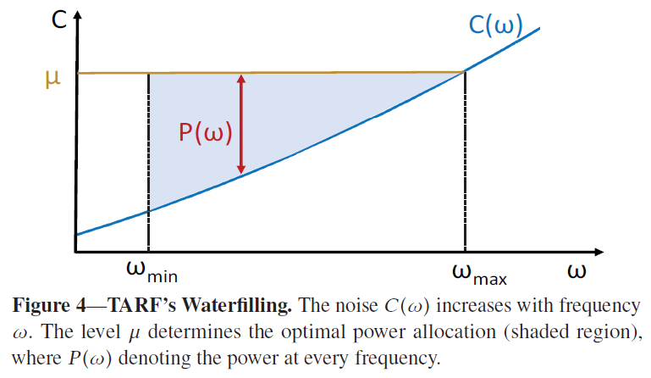

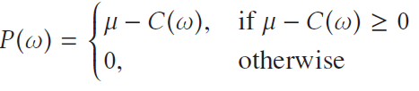


DESIGNING A TARF TRANSMITTER
Waterfilling：

Slide 13
DESIGNING A TARF TRANSMITTER
3. How to modulate the subcarriers?
Specifically, knowing the power allocation P (ω) and the noise function C(ω), TARF can estimate the expected SNR at the receiver and choose the appropriate bitrate based on its estimate. In particular, it can leverage higher modulations (e.g., 64-QAM) at lower-frequency subcarriers (which have higher SNRs) and lower modulation schemes (e.g., BPSK) at higher-frequency subcarriers (which have lower SNRs).
主要根据分析和实验选择合适的调制方法
为了让TARF接收器能正确的对发射数据包进行解码，TARF发射器需要将各个子载波的调制方式告诉接收器，因此TARF发射器会将这些信息写到数据包的首部中

Slide 14
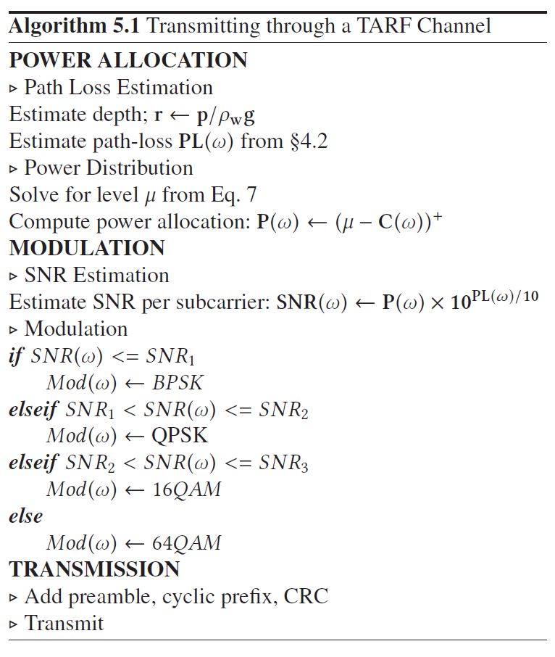
DESIGNING A TARF TRANSMITTER

Slide 15

DESIGNING A TARF RECEIVER
How can TARF capture the minute surface displacements?
Instead of trying to directly estimate the distance, TARF measures the change in distance by estimating the phase of the reflected signal.the phase of the reflected radar signal ϕ(t ) can be expressed as:
where d0 is the distance between the radar and the water surface (in the absence of vibrations) and λ is the wavelength of the radar’s transmitted signal
the TARF receiver leverages a millimeter-wave Frequency Modulated Carrier Wave (FMCW) radar.（三大好处）

Slide 16
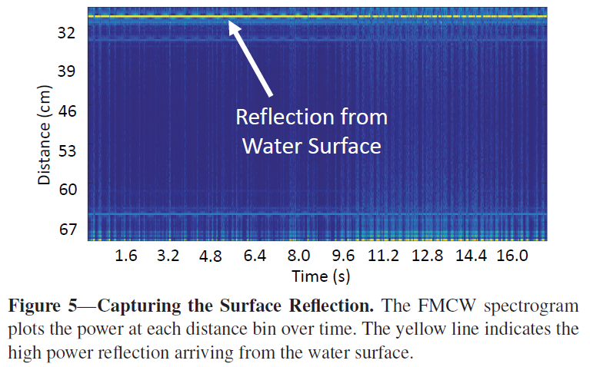
DESIGNING A TARF RECEIVER
Surface Reflection Identification
TARF’s underwater acoustic transmitter 100Hz
To identify the reflection bin corresponding to the water surface, TARF exploits the fact that the water surface has the largest radar cross section, and hence the highest reflection power. In Fig. 5, this corresponds to the solid yellow line.（可以识别哪些反射来自于水面）

Slide 17
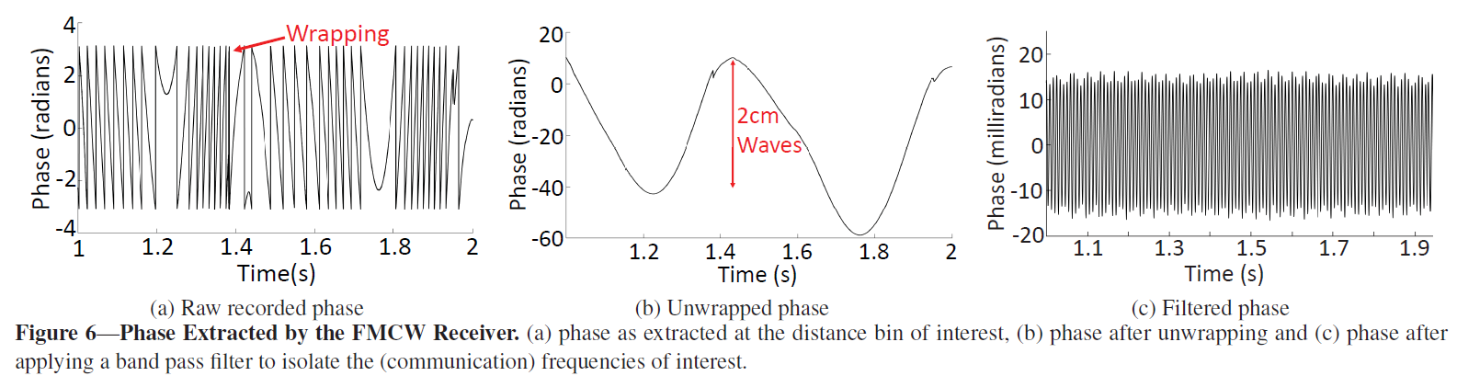
DESIGNING A TARF RECEIVER
② Phase Extraction and Wave Elimination
图a：存在相位缠绕，有来自于水波的干扰
图b：相位解缠
图c：过滤后，可以看出水下的声波发生器正在以150Hz的频率传播单音
由于海波的频率明显（0.1Hz − 3Hz）低于声波的频率（大于100 Hz），因此TARF总是可以根据频率过滤掉海波

Slide 18
DESIGNING A TARF RECEIVER
③ Decoding
前面介绍过，水下的声波发射器会将信道和子载波的调制信息编码到OFDM包的包头中，接收器接收到OFDM包后会首先解析首部，从首部中提取信道和调制信息，然后再对数据包进行解析

Slide 19
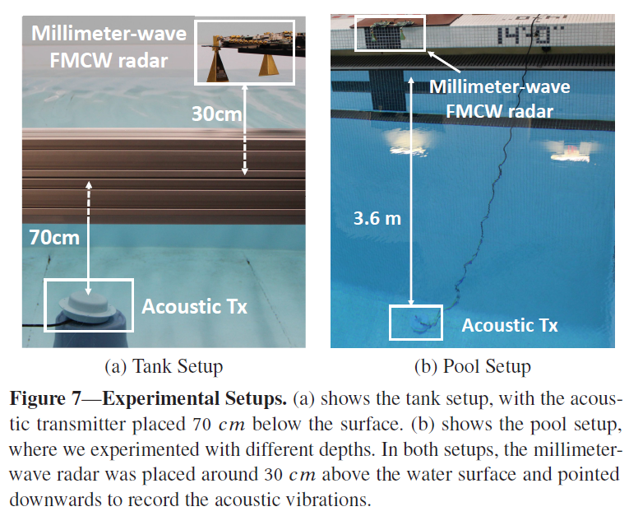
IMPLEMENTATION & EVALUATION

Slide 20
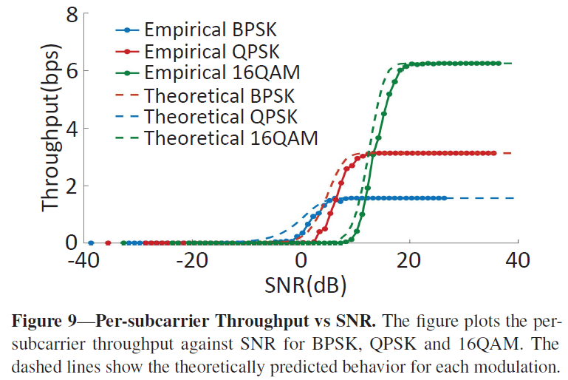
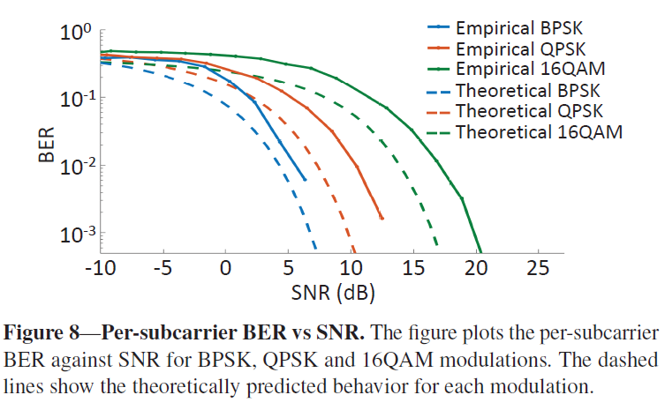
IMPLEMENTATION & EVALUATION
一、主要测量TARF的数据传输吞吐率，声波发射器的OFDM子载波采用四种不同的调制方式： 前三种为：BPSK, QPSK and 16QAM，最后一种是综合子载波的功率分配方式所得到的新调制方式。

Slide 21
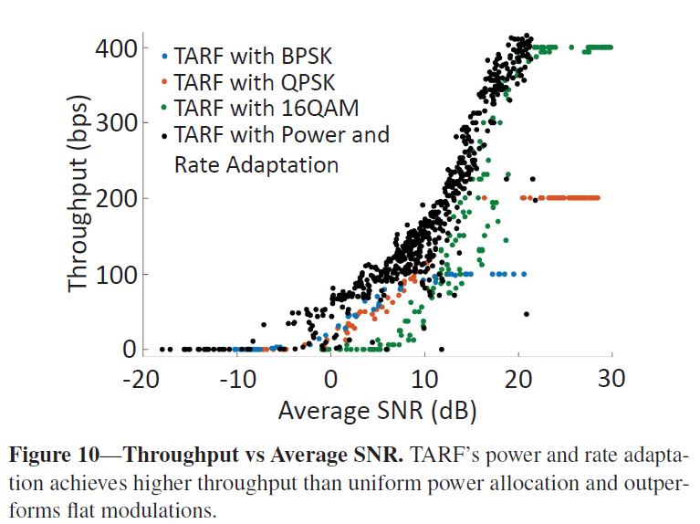
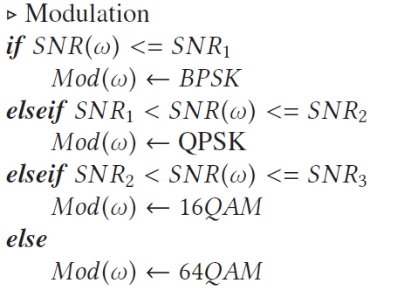
IMPLEMENTATION & EVALUATION

Slide 22
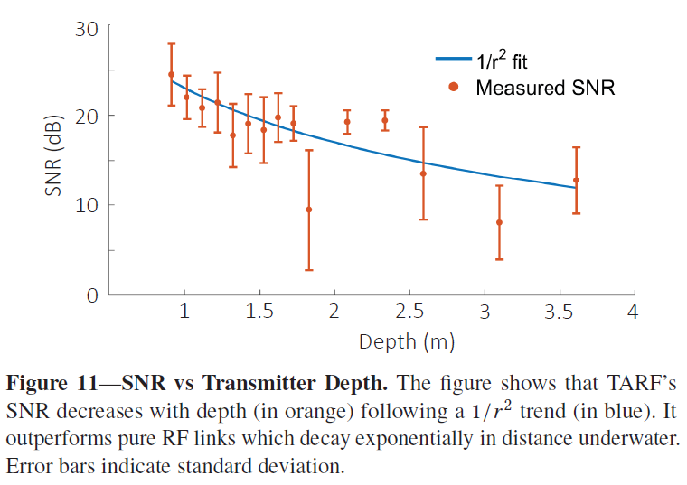
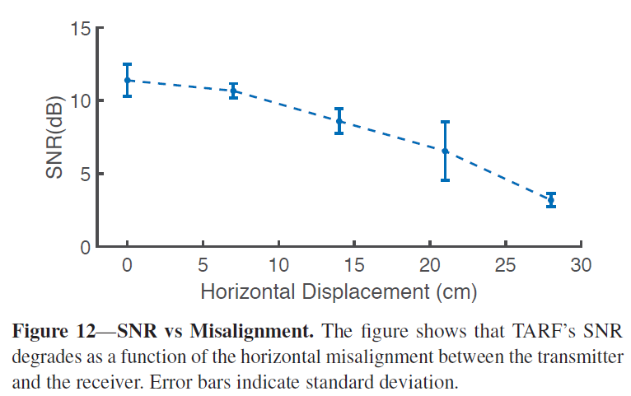
IMPLEMENTATION & EVALUATION
二、测量深度（水下声波发生器）和垂直度（发射器与接收器之间）对接收信号信噪比的影响

Slide 23
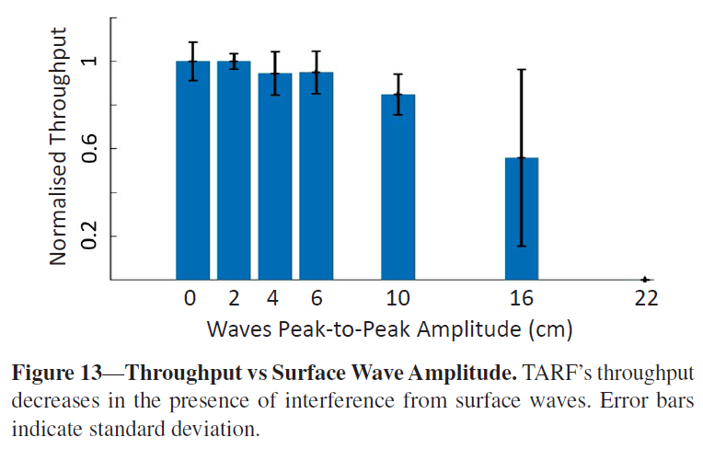
IMPLEMENTATION & EVALUATION
三、测量对干扰波的稳定性

Slide 24
总结与展望
This paper presents TARF, the first technology that enables underwater sensors to wirelessly communicate with compact airborne nodes. TARF transforms the water-air boundary, which has been traditionally considered an obstacle for communication, itself into a communication interface. As such, it holds promise to solve the long-standing problem of crossmedium communications.
应用前景：
Deep-sea Exploration
Submarine Communication
Subsea Internet of Things (IoT)

Slide 25
总结与展望
遗存问题：
One-directional Communication
Ocean Wave Amplitude
Misalignment

Slide 26
The End

